Slide 1
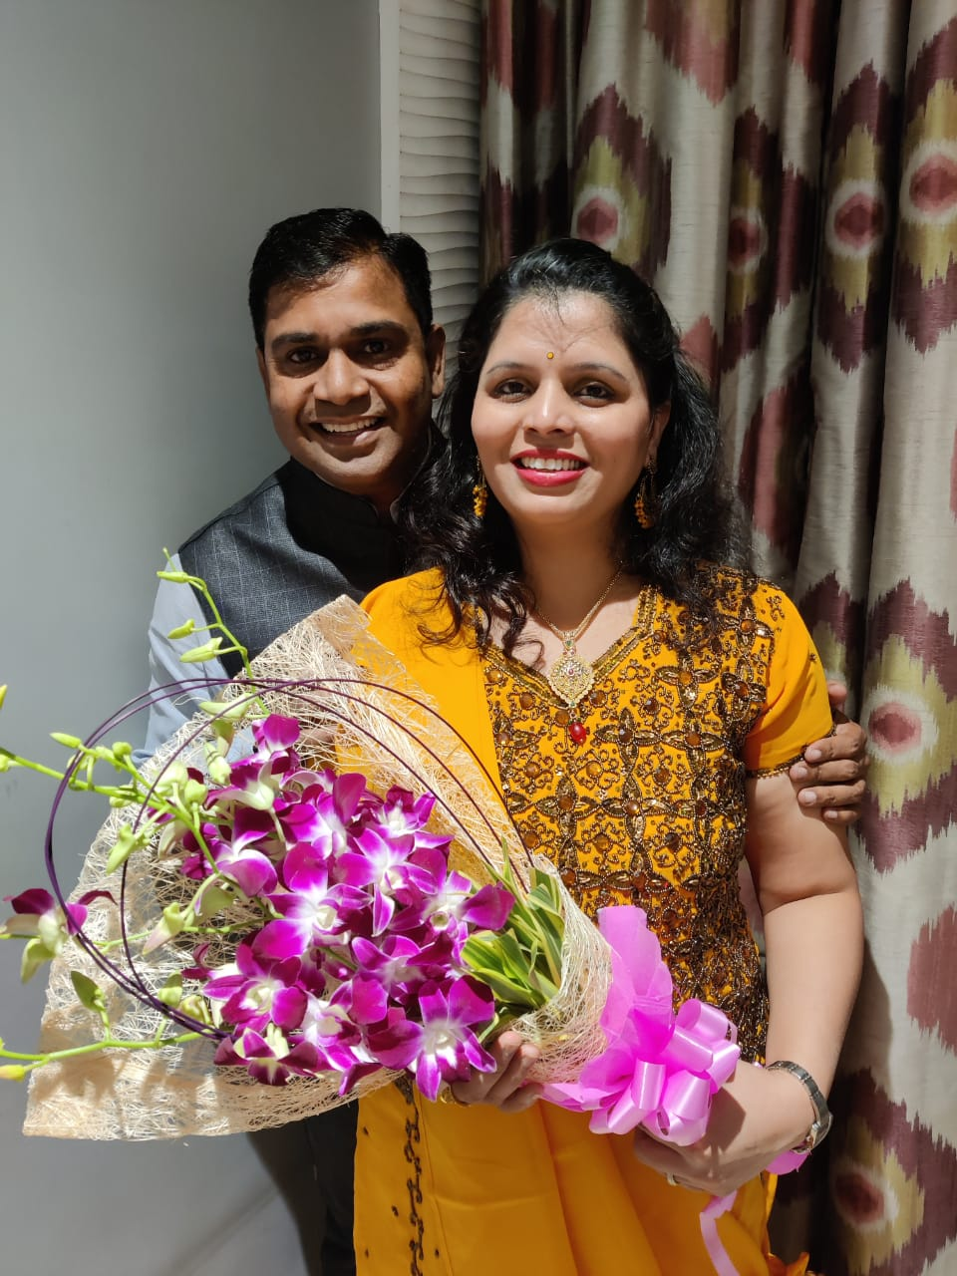
Balance
Width & Depth
Depth Driving
Pranjali & Laxman Nalawade

Slide 2
Depth & Width
A
B
What is Width & Depth?
C
B is Width of A and C is depth of A

Slide 3
Depth & Width
Width = Profitability
Depth = Security + Profitability
Who is Leader?
One who can go wide on his own is a Leader

Slide 4
Depth & Width
Width & Depth gives you choice to work.
Width gives you choice of Legs & Depth gives you choice in same Leg
Best way to motivate your downline is by going wide
I always work where I get Respect.
You have this privilege only when you have choice to work

Slide 5
Best CD for Depth Driving
Think Fundamental & Grow Rich

Slide 6
A
DEPTH DRIVING
B
C
A is your leg
Help him go 4 wide. You do 4 basics.
    List, Call & Invite, STP & Joining
Find out who is excited; Suppose B. Do 4 Basics with B. Help him to go 4 wide
Find out C. Repeat
Find out D. Repeat.
Depth Never Stops
D
E

Slide 7
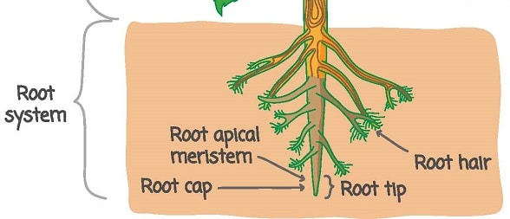
Work with the deepest point
Teach A,B,C, & D to duplicate you and work in their other legs
Involve them, Never go alone
Love uplines and work with downlines
Imp Question – Who is after me?
Biggest LOB at lowest Level
Strong Side Volume – 6000 PV
Number of LOB & Strength of LOB

Slide 8

Mistakes in Depth Driving
Delegation of Depth
Not working on the creative end of the business (Root Cap)
Not promoting uplines to your downlines.
You need to be magic in your team till you go Director. After that you need to have a magician in every leg.
Getting comfortable with your immediate width / leader
Not making downline profitable
Plugging People in Big Meeting
Small Zoom Meetings will grow you business. Big meetings will maintain your business
Changing focus from leg that has momentum

Slide 9
Thank You

